Slide 1
Title : EZKit and EVAL Melody Platform Introduction
16 Oct 2024
Presented by:
Vaithegi G
Sangeeth S

Slide 2
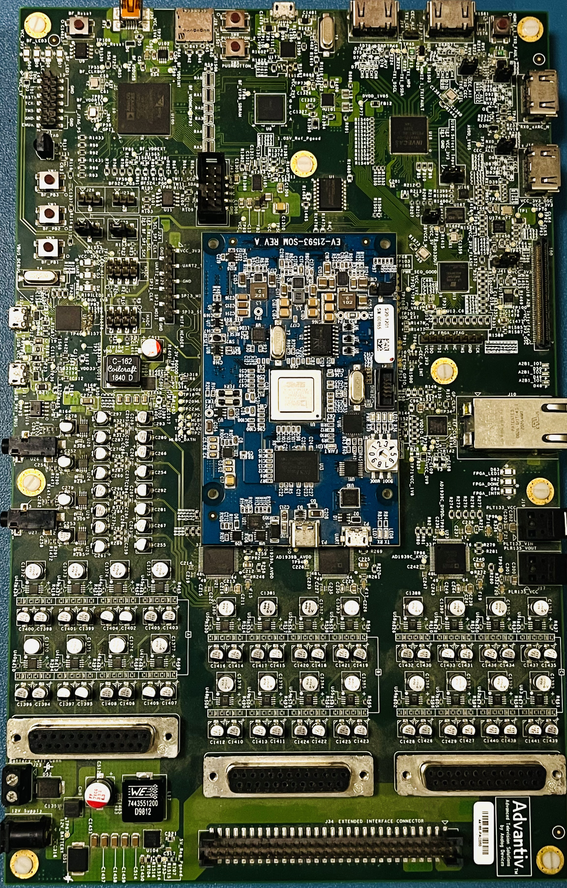
Can you recall?

Slide 3
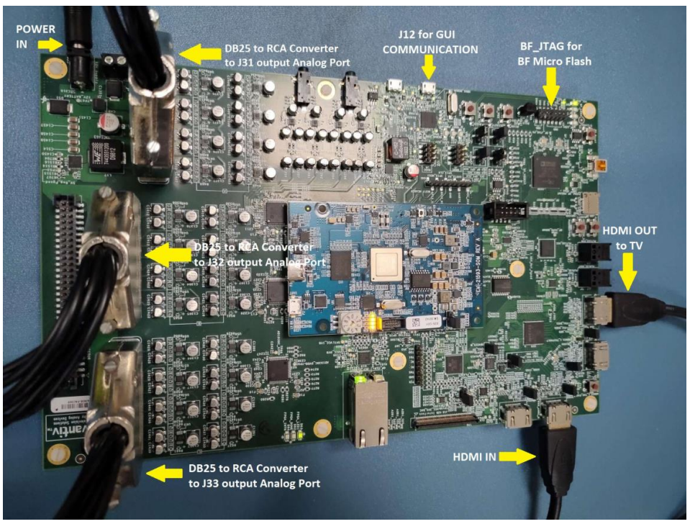
ADSP-21593(Eval Melody-9) Hardware

Slide 4
Offline testing
Connect the micro-USB cable to "J44" port and Emulator to the "P1" port of ADSP-21593 Eval Melody-9 Rev 'B' board and power should be turned ON.
In DTSX_PRO_on_ADSP21593_35Ch_Offline -> Build_CCES folder, go to kernel_Core1->Debug folder.
Copy and paste Input streams and "input_list.txt" file in the Debug folder.
Open CCES 2.11.1 and Create a Workspace
Go to Debug Configurations->Application with CrossCore Debugger.
Select Processor family as "SHARC->ADSP-21593" and click Next, select the type of target as Emulator and click Next and Select the proper platform ( ICE-1000/ICE-2000 ) and click Finish.

Slide 5
Conti...
In the Debug Configurations Window, kindly check whether Preloder is loaded automatically on the debug configuration window. If it is not there, choose preloader from the cces installation path. Path:(C:\Analog Devices\CrossCore Embedded Studio 2.11.1\SHARC\ldr\ezkit21593_preload_core1.dxe).
Browse and select proper (.dxe) files of kernel_Core1 & kernel_Core2 project from DTSX_PRO_on_ADSP21593_35Ch_Offline folder.
Now click Apply and Debug to launch the WorkSpace, Select Debug window. Run the Project.
Go to Debug folder Run the cmd.bat file "Decoding stream 1 out of ..." will be printed on console window. After completed decoding of all the input streams, "Decoding Completed" will be printed in the console window.

Slide 6
Realtime testing
Connect the micro-USB cable to "J12" port and Emulator to the "P1" port of ADSP-21593 Eval Melody-9 Rev 'B' board and power should be turned ON.
Load preload dxe for Core1 and Core 2 (Debug\21593_preload_Core1.dxe)
Run the code and pump the stream.
Check the StreamType in the code.
Check audio output from codec.

Slide 7
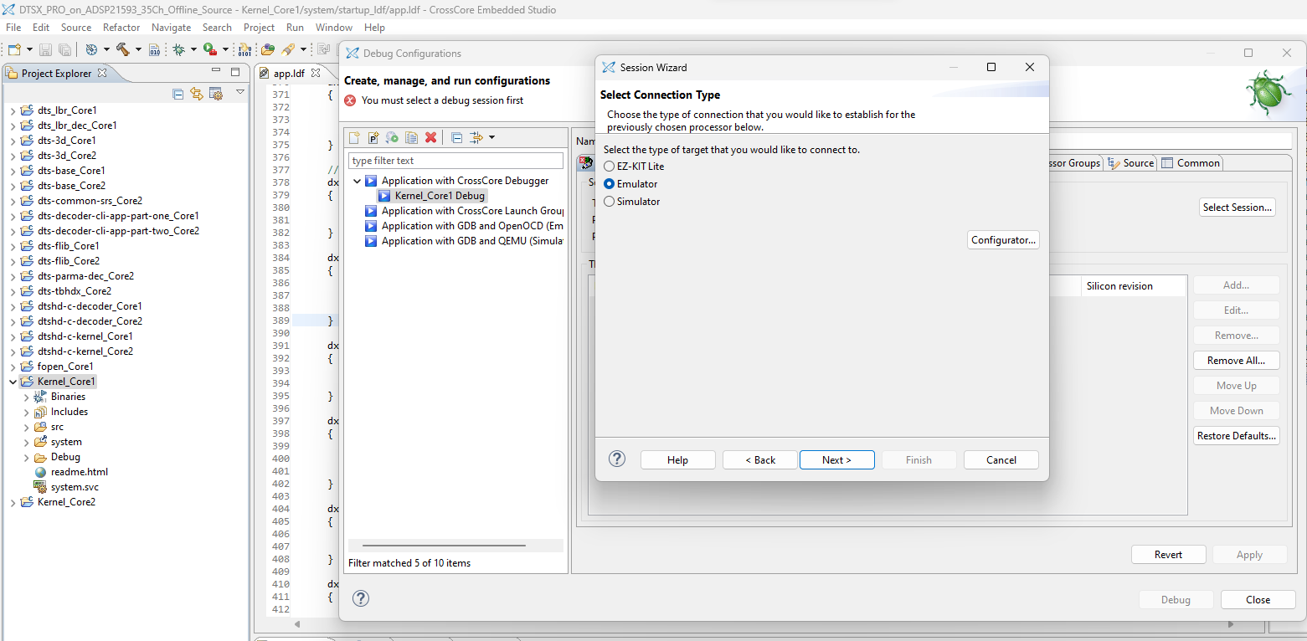
Debug configuration

Slide 8
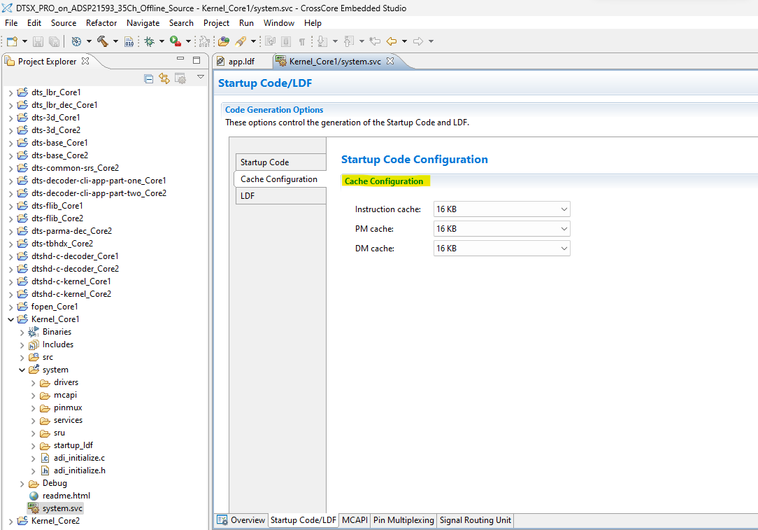
Cache configuration

Slide 9
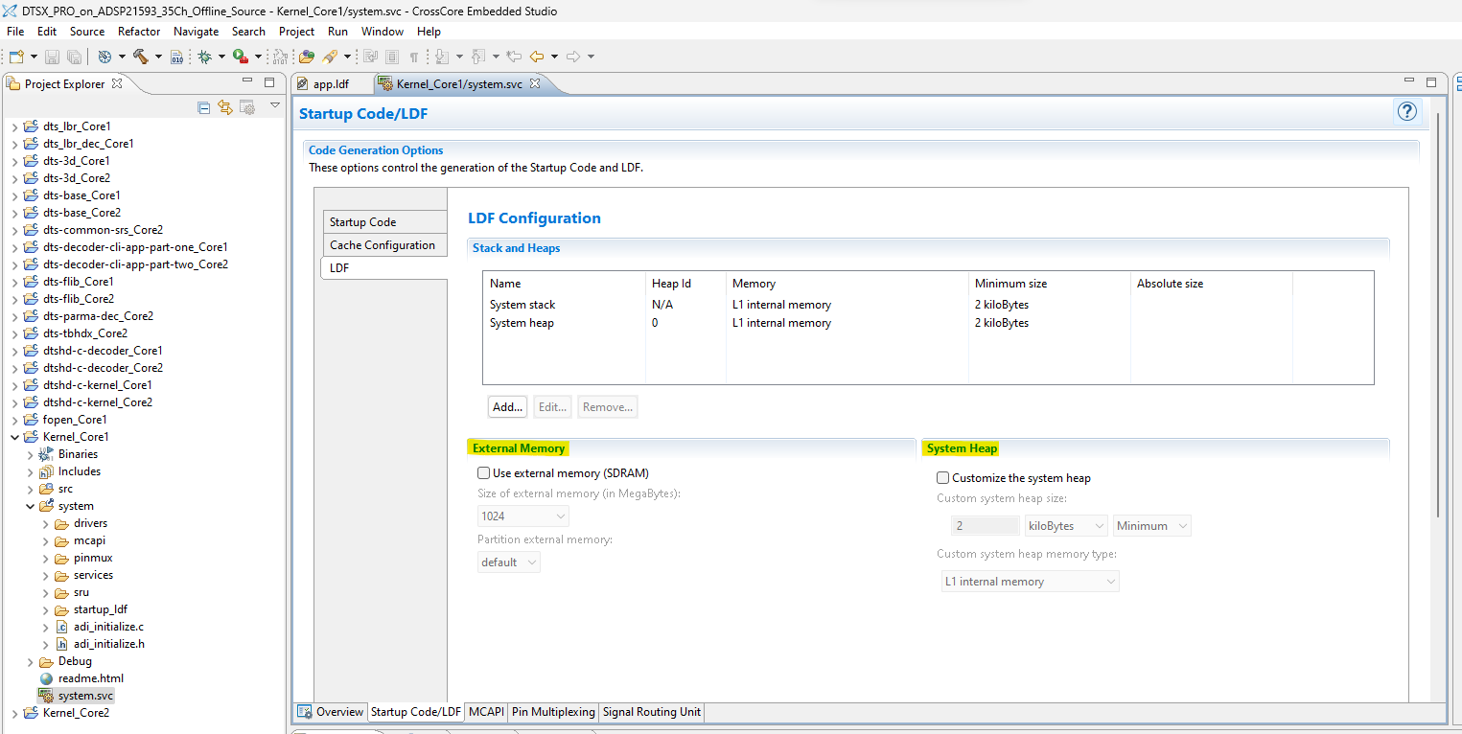
LDF configuration

Slide 10
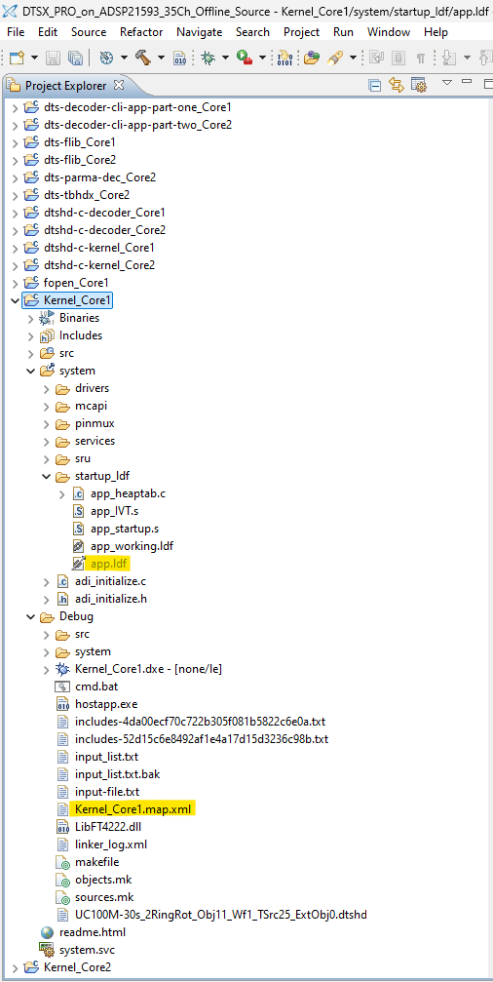
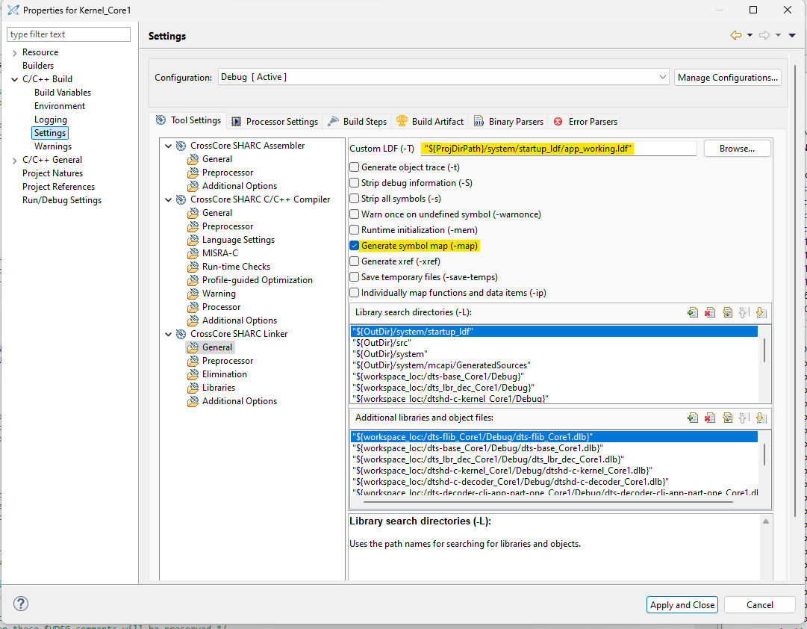
Ldf and Map file Path:

Slide 11
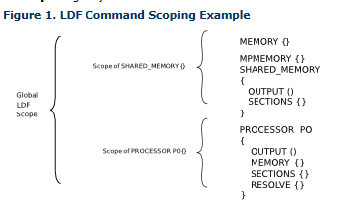
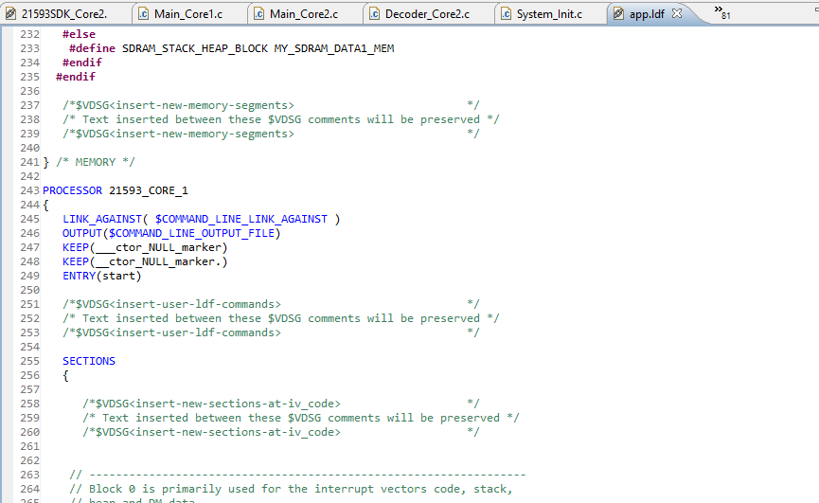
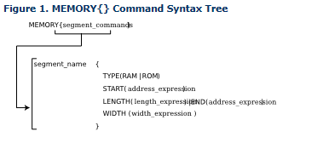
Memory segments in ldf (Linker description file)

Slide 12
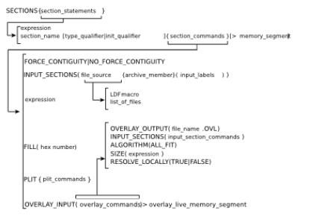
SECTIONS{} Command Syntax Tree

Slide 13
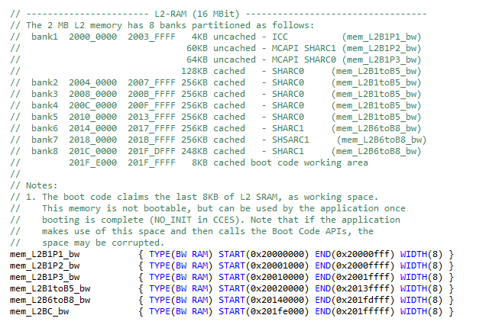
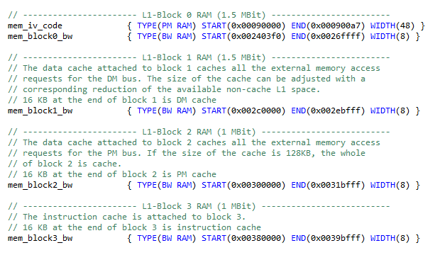
Memory segments in ldf (Linker description file)

Slide 14
Built In LDF Macros
$COMMAND_LINE_OBJECTS - This macro expands into the list of object (.doj) and library (.dlb) files that are input on the linker's command line. Use this macro within the INPUT_SECTIONS() syntax of the linker's SECTIONS{} command. This macro provides a comprehensive list of object file input that the linker searches for input sections.
$COMMAND_LINE_LINK_AGAINST - This macro expands into the list of executable (.dxe or .sm) files that one input on the linker's command line. This macro provides a comprehensive list of executable file input that the linker searches to resolve external symbols.
$COMMAND_LINE_OUTPUT_FILE - This macro expands into the output executable file name, which is set with the linker's -o switch. This file name corresponds to the <projectname.dxe> set via the IDE Tool Settings tab. Use this macro only once in your LDF for file name substitution within an OUTPUT() command.
$COMMAND_LINE_OUTPUT_DIRECTORY - This macro expands into the path of the output directory, which is set with the linker's -od switch (or -o switch when -od is not specified). For example, the following statement permits a configuration change (release vs. debug) without modifying the .ldf file.

Slide 15
Type_qualifier
The width qualifier can only be specified immediately following the type qualifier. When no width qualifier is present, the following default widths are used for each type:
BW ("byte-wide"): 8 bits / 1 byte per word (ADSP-215xx/SC5xx only)
SW ("short word"): 16 bits / 2 bytes per word
DM ("data memory"): 40 bits / 5 bytes per word
PM ("program memory"): 48 bits / 6 bytes per word
DATA64 ("64-bit data"): 64 bits / 8 bytes per word

Slide 16
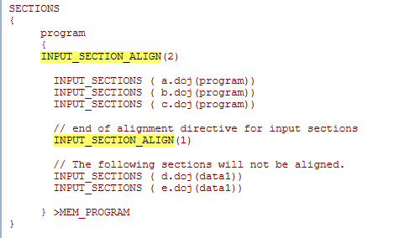
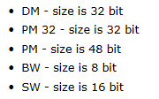
INPUT_SECTION_ALIGN() Command
In the following Blackfin example, input sections from a.doj, b.doj, and c.doj are aligned on even addresses. Input sections from d.doj and e.doj are not double-word aligned because INPUT_SECTION_ALIGN(1) indicates subsequent sections are not subject to input section alignment.
FILL(0x1)

Slide 17
Init_qualifier
The qualifiers are:
NO_INIT - contains uninitialized data. There is no data stored in the .dxe file for this section
ZERO_INIT - contains only "zero-initialized" data.
RUNTIME_INIT - if the linker is invoked with the -meminit switch, this section fills at runtime. If -meminit is not specified, the section fills at "load" time.

Slide 18






India, Germany, Japan, USA & China
+91 44 6666 9600
www.jasmin-infotech.com
THANK YOU!

